Slide 1
DISK CLONING
using MINITOOL offline

Slide 2
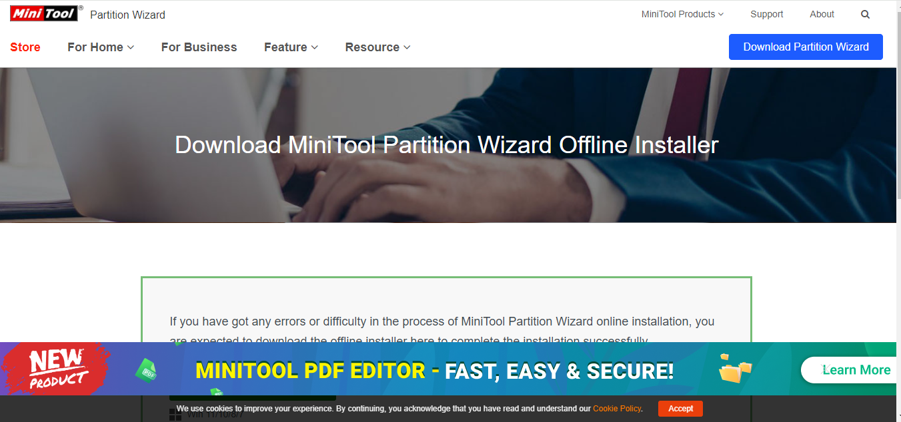
DOWNLOADING minitool
Visit google and type minitool download
Why offline?
Sometimes you may not have access to the internet but you are stuck and you have to perform the cloning processes
Having the offline version of the software will enable you to run wherever and anytime you desire

Slide 3
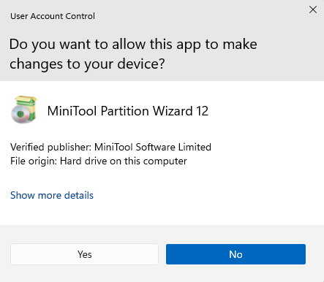
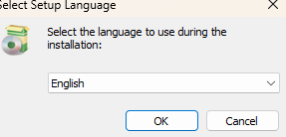
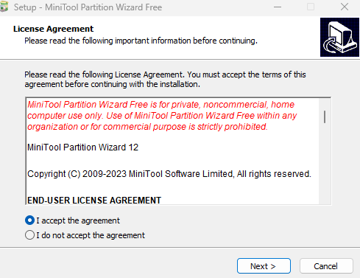
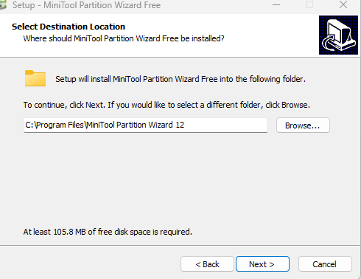
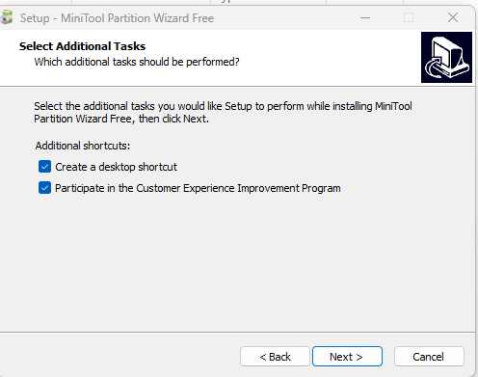
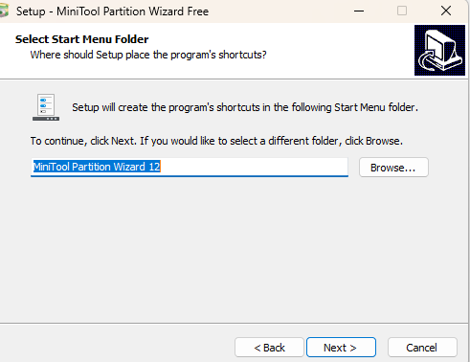
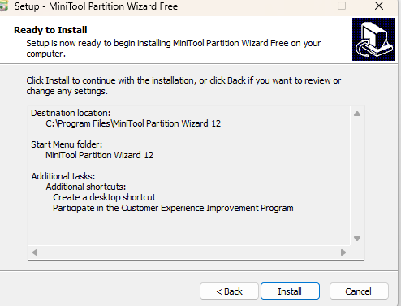
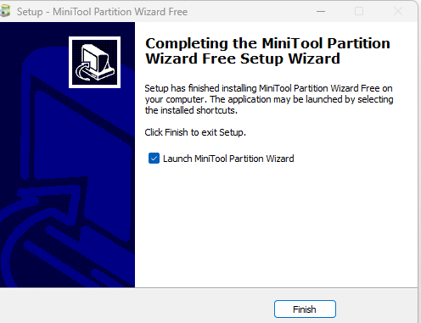
Follow some few steps after downloading so as to install minitool successfully

Slide 4
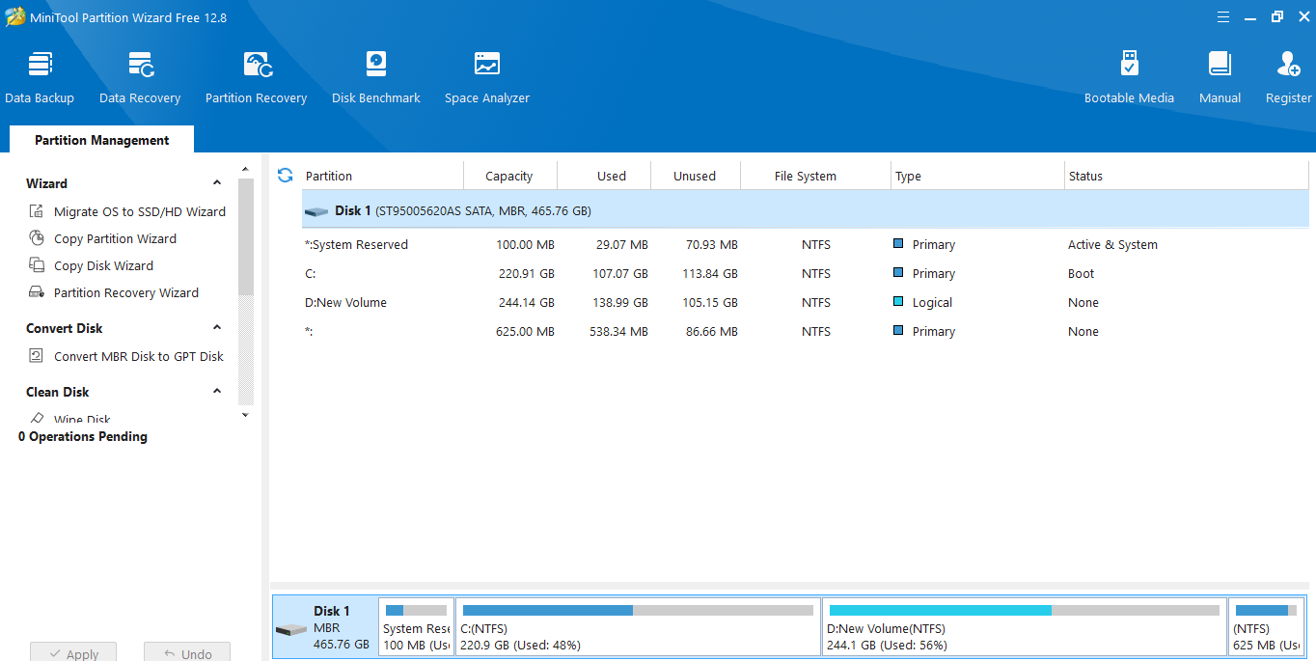
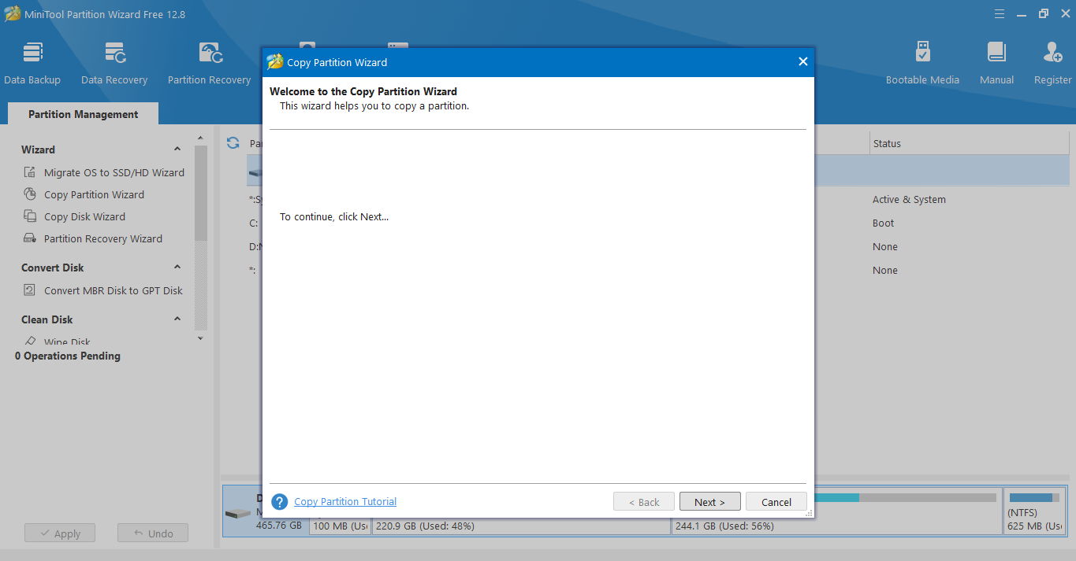
After installing minitool in the previous slide now we need to start the steps of cloning
click on NEXT

Slide 5
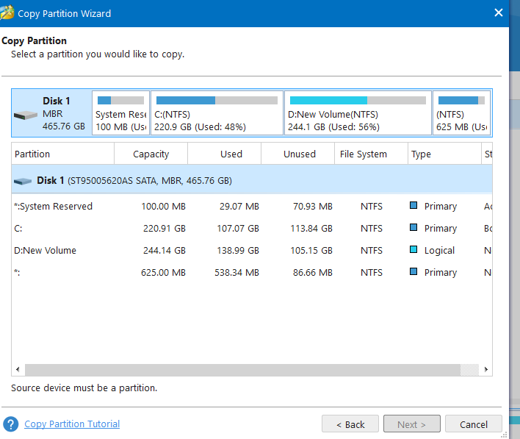
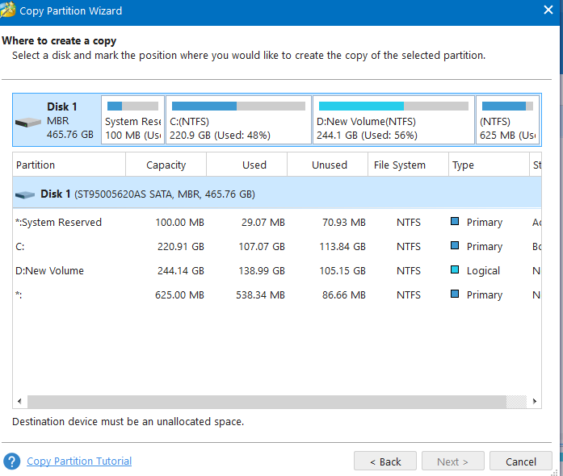
Here you have to click on the partition ,you would like to copy
For this case it is local disk c:
Next, you have to select the partition where you want to copy your local disk c:
You now have to make that partition unallocated that means you must format it

Slide 6
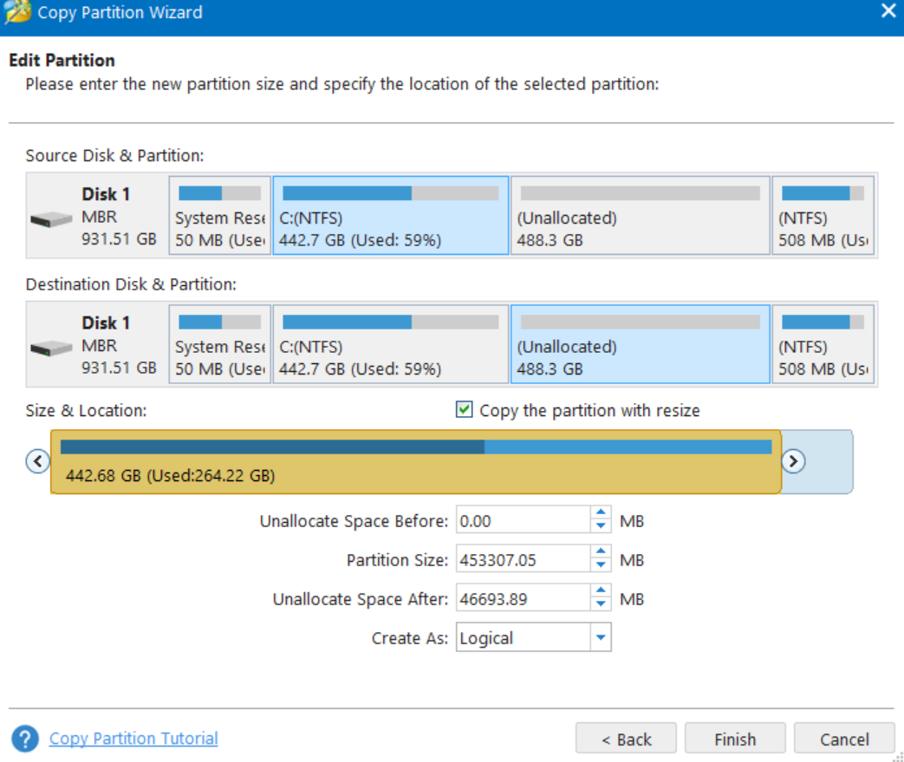
Here is the final step. You have to click on finish and apply to perform the clonning

